Slide 1
Advanced C++
Chapter 9 (Review Objects)
Fall 2011
Kristina Shroyer

Slide 2
Objectives
Chapter 9
  This Chapter picks up right about where we left off in my CSIS C++ class (regarding objects) while at the same time reviewing object oriented programming
  If you've forgotten object oriented programming I saved the lecture from C++ (CSIS 135) in the lecture slides folder
    This is a very detailed intro to objects if you have forgotten from your introductory C++ class
Be Able to Work on Object Oriented Review Program - HW #1
  HW #1, getting warmed up and remembering objects
  Keep it Simple (these are recommendations but following good design is required, I do not care if it "works" – we do not want hack code in this class, we went well designed code)
    Think about your object oriented design first (good design will save time)
      What are your member variables?
      What are your member functions?
    I would recommend using a 2D Array for the game board and having numbers the user selects to represent which box they would like their 'X' or 'O' in
    I would also recommend using 1's and 0's (or maybe 0's, 1's, and 2's) instead of X's and O's
      This will make it easier to check for a win
    Don't forget your UML diagram
Review Questions: What is the difference between an array in Java and an array in C++? Can you change the size of an array (without a pointer) at run time in C++?

Slide 3
Chapter 9 Objectives
Review Objects
Review/Learn how to use a preprocessor wrapper to prevent multiple definition errors caused by including more than one copy of a header file in a source-code file.
To understand class scope and accessing class members via the name of an object, a reference to an object or a pointer to an object (we will review pointers in detail in the next lecture and program with them a lot this semester).
Review Constructors/ Define constructors with default arguments.
Learn how destructors are used to perform "termination housekeeping" on an object before it is destroyed.
Learn when constructors and destructors are called and the order in which they are called.
Learn the logic errors that may occur when a public member function of a class returns a reference to private data.
Learn/Review how to assign the data members of one object to those of another object by default memberwise assignment.
Pay attention to DESIGN as we go through the lecture, we want modern, well designed code (do not fall into old school, procedural traps that lead to non-reusable, hard to modify/maintain code.

Slide 4
User Defined Data Types/Abstract Data Types
Let's review the concept of an Abstract Data Type (ADT) and Object Oriented Programming (OOP)
  In OOP we define ADTs to be used in programs and work together by creating instances of each other (we use classes to do this).
    These ADTs are resusable and can be used by many different programs just by creating an instance of the ADT (an object).
      Think of the string
    This is similar to how we create variables that are instances of primitive data types
Abstract Data Types (User Defined Data Types/Class Data Types)
  Definition: The term abstract data type (the definition of an object) describes any data type for which the implementation details are kept separate from the logical properties needed to use it
    In common usage the term is applied only to data types created by the programmer (this is why you may hear it referred to as a User Defined Data Type)
    Often abstract data types hold more than one value similar to structures we studied in the previous chapter
  A programmer usually creates an abstract data type by:
    Defining a set of values the data type can hold
    Defining a set of operations that can be performed on that data
      Creating a set of functions to carry out these operations
  In C++ and other object oriented languages, programmer created Abstract Data Types (User Defined Data Types) are normally implemented as classes.
In object oriented programs, objects (instances) of ADT's interact with each other
Remember our definition of a data type: a set of values AND all the operations that can be applied to those values
Notes:
Review: What is a data type? What is a primitive data type? What is a class data type? Objects real world. Rectangle, Address Book.

Slide 5
Object Oriented/Procedural Programming
Procedural Programming vs. Object Oriented Programming
There are two common programming methods in practice today
  Object Oriented Programming (most applications)
    Supports the idea of ADTs by using a structured type known as a class
      A class is used to define of an abstract data type
      Just as we create instances of primitive data types (ints, doubles etc) called variables we also create instances of classes (definitions of ADTs)…these instances are called objects
    Is based on the idea of an ADT (an ADT’s data and the functions that operate on that data).
    A class is used to define an ADT
      Objects are instances (specific ones) of class Abstract Data Types, or User Defined Data Types
        Definitions of objects add something to definitions of structs…the operations that act upon the data that make up the data type
  Procedural Programming (legacy code and some specialized types of applications)
    focuses on the process/actions that occur in a program and treats data as a passive separate entity that processes act on
      the important concept is that the data and the processes that act on the data are separate, think of all the data passing back and forth between functions
    In procedural programming data values are treated as passive quantities to be acted upon by functions
      functions pass "passive/static" data back and forth between each other
    Procedural Programming does not correspond very well with the idea of an abstract data type
      An ADT consists of BOTH data values and the operations on those values defined in the same structure
      It is preferable to view an ADT as defining an ACTIVE data structure
        One that combines both data an operations in to a single cohesive unit

Slide 6
Procedural Programming
What is Procedural Programming?
  Procedural Programming Diagram
  This procedural program will grow to have more and more functions as it becomes more complex
  While functions are easier to trace and understand than having the entire program in one main method (linear), as a program becomes more complex and contains increasingly more methods it can become harder to read and follow
    This makes the program harder to:
      Design
      Modify
      Debug
PROGRAM
MAIN FUNCTION
-local variables (data)
-Programming
  -Calls to other functions passing data to and from those other functions
FUNCTION A
-local variables (data)
-Programming
  -Calls to other functions passing data to and from those other functions
FUNCTION B
-local variables (data)
-Programming
  -Calls to other functions passing data to and from those other functions

Slide 7
Procedural Programming
Limitations of Procedural Programming
  Complex Programs
    A program may be broken into many different functions to allow easier understanding of the program
      However, there is a limit to the number of functions a person is capable of understanding and remembering
      It’s common for real world programs to have hundreds of functions that interact with each other in many different ways
      This complexity creates problems for a new programmer brought in on a project
  Programs that are Difficult to Modify, Debug, or Extend
    What happens when a program reaches a certain level of complexity?
      It becomes difficult to modify (extend, change or debug) and understand how modifications may affect other parts of the program
        Functions pass data amongst each other and modify it creating dependencies between two or more methods (what happens in one method affects another)
        When a programmer alters one function the changes they make may unknowingly affect other methods in ways the programmer did not intend

Slide 8
Procedural Programming
Limitations of Procedural Programming
  Excessive global data
    The public accessibility of global data can open the door for a programmer to write code that accidentally corrupts vital data
    Errors in these types of programs be hard to find
    It is difficult to modify a function in this type of program without having to also modify other functions that are affected by that function’s data
  These types of procedural programming problems can cost companies money
    Programs that are hard to modify and debug take more time for the software developers/programmers which in turn costs money
    Programs that are not readable make it hard for a new software developer to start later in the project or to come in later to maintain code
      This happens often
    Object Oriented programming has been shown to reduce these problems and related costs

Slide 9
Object Oriented Programming – Big Picture
Classes are normally Abstract Data Types (User Defined Data Types) which contain BOTH data members and a set of operations that operate on those data members.
  Just as you can create many variable instances of primitive data types you can also create many object instances of classes (the definitions/blueprints that define abstract data types)
Definitions:
  Class: A structured data type in a programming language that is often used to represent (define) an abstract data type
    Think of it as a blueprint or definition for an abstract data type, like a struct, it only DEFINES the ADT, you can't use it until you create a variable (object) of that type
  Class member: A class member is a component of the class. This is similar to a member of a struct except class members are BOTH data and the functions that operate on that data.
  Class object (class instance): Instances of classes are called objects. These are instances of the class type created (similar to how a variable is an instance of a primitive data type).
  Client: Any software that declares and manipulates objects of a class type is called client of the class

Slide 10
Review UML
Before you start coding your object oriented program you need to think about what abstract data types your program needs (there will be more than one as we get going in this class) and you need to think about how the abstract data types in your program work together
  How does each ADT in your program relate to each other and how do they need to communicate with each other?
    Remember each ADT in a program can contain member variables of not only the primitive type but also of other class types/other ADTs (we go over this in detail in chapter 10) – this includes programmer created class data types/ADTs
  If you were creating an Asteroids game what ADTs would you need in your program?
    NOTE: This design goes through several phases, as you plan your design you might find that you want to change the classes you have and their members, the design phase is critical and should be completed in detail before ANY programming begins
  One way to start thinking about what data types you need is to look at or write a description of the problem you are solving/program you are creating.
    Then circle all the nouns – a lot of the nouns (not all of them) will end up being data types you need
      This can serve as a starting point in your design
You will use UML diagrams for each object oriented program you do in this class
  Designing the program/project can involve many many ADTs and planning the best relationships between the ADTs is crucial to good code, this is what distinguishes an engineer from a programmer, the engineer plans good code
  Remember we don't need perfect UML, just what I call UML lite (enough to diagram what we are doing)
    As we go along in the class I'll show you how to use your UML to model relationships between classes as well (Composition, Inheritance etc.)

Slide 11
Review UML
The first step in any object oriented program is object oriented design
  Plan for the High Level Conceptual Object you are creating. This is the phase of programming where you are planning your design you are going to use to write your formal class declaration.
When designing a class it’s often useful to create a UML diagram
UML Diagrams
  UML stands for Unified Modeling Language
  It is used to graphically depict object oriented programs
  This comes in useful for really big programs with large numbers of objects communicating with each other
    Objects can also have special relationships with each other that can be communicated graphically though a UML diagram such as Inheritance
  In the real world problems/programs are so complex designing the UML diagram is a major part of the work
    Poorly designed object diagrams can lead to a poorly designed program that is not easy to use or re-use…it could also lead to the re-design of a program
    There is an entire class at CSUN just on Object Oriented Design and UML
  So we are going to learn just some of the very basic concepts of UML which will seem unnecessary for the simple programs we are designing but once you start designing more complex programs it will make sense why we learned it.
  Object Oriented Design refers to the planning for the various classes in a program
    UML Depicts the relationships of classes to each other within a program as well as the way classes communicate with each other

Slide 12
Review UML
UML Diagrams
  General Layout for a UML Diagram for a single class
    In a complicated program with several classes there will be several of these class diagrams with connectors between them showing the relationships between the classes in the program
  In a UML diagram you have the option of showing the access specifier of each member
    A “-” before a class member indicates it is a private member
    A “+” before a class member indicates it is a public member
  Constructors should go in the UML
We are using UML lite for this class which is casual UML to use as a planning tool
  There is more on UML in the detailed review slides
PET
-type: string
-name: string
-age: double
+Pet()
+double: getAge()
+string: getType()
+string: getName()
+bool: setType(ty:string)
+bool: setName(n:string)
+bool: setAge(a:double)

Slide 13
Object Oriented Design – Video Store
PERSON
MANAGER
CLASS DIAGRAM: ALL CLASSES
PRODUCT
0..*
0..*
TRANSACTION
EMPLOYEE
MANAGER
CUSTOMER
MANAGER
1..*
0..*
1
1
MEDIA
NON-MEDIA
1
PERSON
1
TRANSACTION
HISTORY
INVENTORY
MANAGER
0..*
0..*
1
EMPLOYEE
CUSTOMER
1
1..4
SALES
INVENTORY
MANAGER
RENTAL
INVENTORY
MANAGER
PAYMENT
TYPE
MANAGER

Slide 14
C++ Class Design Review
Let's outline a Rectangle class data type UML and class
Concept: The class declaration/specification is stored in their own header files (.h) and the class implementation section (function definitions) are stored in their own .cpp files (C++ source files)
  Remember the whole point of the ADT is to keep the declaration/specification SEPARTE from the implementation – a client program ONLY needs the declaration/specification to use the data type, not the implementation (remember the car example from CSIS 135)
  All of the programs we wrote when we first learned objected based programming had the class declaration, the function definitions (implementation section), and the application program (the client - main in our case) all in one file
  The more conventional way of designing a C++ program (and the way we will use) is to store the class declaration section (the specification) and the implementation section in their own separate files
    In addition, since there will be many different clients using the class (classes should be reusable) each client program should also be saved in a different file
  An abstract data type has two parts: a specification (declaration) and an implementation
    The class declaration (specification) describes the behavior of the ADT without reference to it's implementation
      In other words the class declaration describes what the class does without going into detail about how it works (data abstraction)
      A client can use a class looking only at its declaration
    The class implementation creates an abstraction barrier by hiding the concrete data representation as well as the code for the operations
  Why separate the implementation and declaration?
    By having this separate this also means we could change the implementation without needing to change the declaration (we'll talk about all this more as we go through Chapter 9 next in your textbook)
    Think of having the declaration and implementation separate as keeping the "what" separate from the "how", which is a key part of the definition of what an ADT is
    soda machine example

Slide 15
Chapter 9
In this book, the author likes to present one example and study it throughout a few Chapters
In this Chapter the Time Class Definition is introduced (so an Abstract Data Type named Time)
  Remember an ADT is a set of data and the operations that act on that data, and remember with an ADT the key concept is keeping the what separate from the how, so a client program can use an ADT without needing to understand the details of how it works
  So the class Time is the definition of the ADT Time
    When we use the Time class in a program we will create an instance of the Time class definition (an object)
I've saved the various versions of the Time class files in the Instructor Folder
Remember Our Time class definition is divided into two files.
  The class declaration (Time.h)
    The class declaration (specification) describes the behavior of the ADT without reference to it's implementation
  The class implementation (Time.cpp) – this is the how, the function definitions for our ADT
  Our driver function (the client) will be in a separate file
    Many many clients should be able to use the Time ADT for their own purposes
  We will have all of these files included in Visual C++ project, I'll show/review how to create a project in Visual C++ Express in class

Slide 16
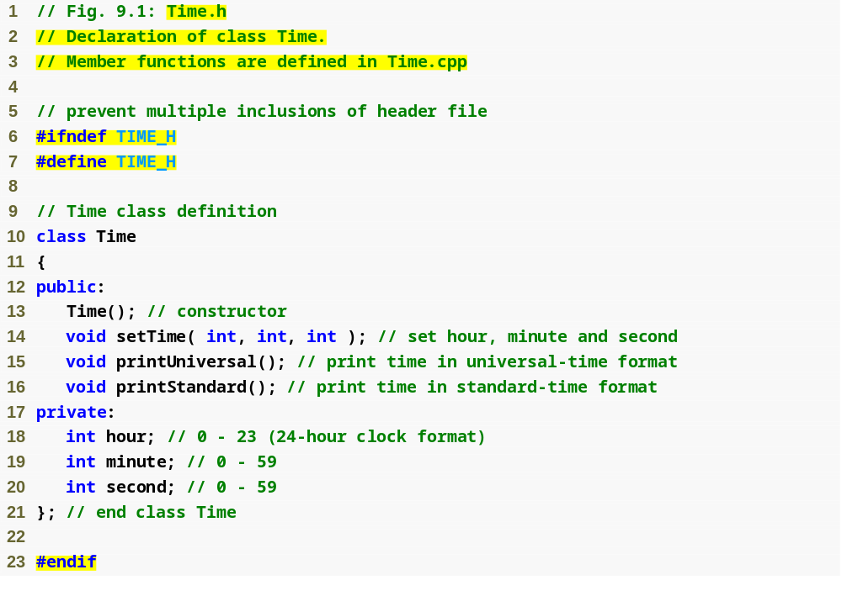
declaration
Example 1 - Time (Fig 09_03)
Review: What is this code: Time() ?
Question: Why are the comments
here important?
Review: Why are the class data members (member variables private? )
What concept of object oriented programming does this illustrate?
Review: What is encapsulation?
What's different about this than what we did in CSIS 135?

Slide 17
9.2 Time Class Case Study
Preprocessor wrappers are highlighted in the example code we just looked at
  Using these wrappers prevents code from being included more than once in a project, a class can be defined only once so multiple includes cause errors in code – we will have projects with multiple classes in them this semester so this semester this could actually cause a problem, you will get a linker error if you try to include/link a class into a project twice
    #ifndef – “if not defined”
      Skip this code if it has been included already
    #define
      Define a name so this code will not be included again
    #endif
      This ends the block of code that is skipped if it has been included in the project already
  If the header has been included previously
    Name is defined already and the header file is not included again
  Prevents multiple-definition errors
    Think of it as trying to include two Time class definitions in the project, the compiler would not know which one to use when an instance of the Time class is created – only one Time class definition should be in the project
  Example
    #ifndef TIME_H
    #define TIME_H
    … // code
    #endif

Slide 18
Preprocessor directive #ifndef determines whether a name is defined
Preprocessor directive #define defines a name (e.g., TIME_H)
Example 1 - Time (Fig 09_03)
Preprocessor directive #endif marks the end of the code that should not be included multiple times

Slide 19
Good Programming Practice 9.2
Use the name of the header file in upper case with the period replaced by an underscore in the #ifndef and #define preprocessor directives of a header file.
  This is the commonly used convention
  So if the name of your class was Rectangle
    #ifndef RECTANGLE_H
    #define RECTANGLE_H
    … // code
    #endif
Review: What do we mean
by a convention?

Slide 20
Software Engineering Observation 9.1
Each element of a class should have private visibility unless it can be proven that the element needs public visibility. This is another example of the principle of least privilege.
Why is it better to use a named constant with the word const
instead of a #define for REGULAR named constants that
are inside a class or part of a client program (not
constants used for preprocessor directives)?

Slide 21
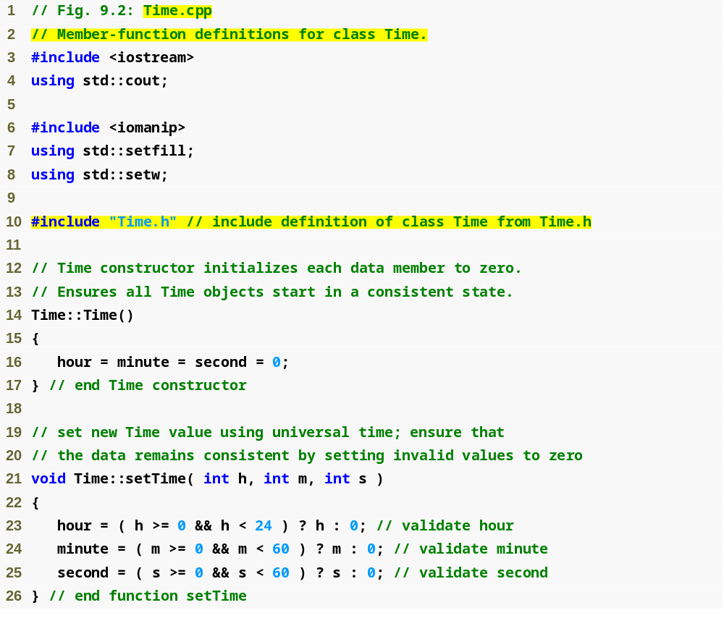
Example 1 - Time (Fig 09_03)
Time.cpp
(1 of 2)
Where is data hiding used and
how?
Ensure that hour, minute and second values remain valid
Notes:
NOTE: I just used: using namespace std;
The constructor sets the private members to zero to ensure they remain in a consistent state, the class is designed to prevent invalid values from ever being in the private members. DATA HIDING!

Slide 22
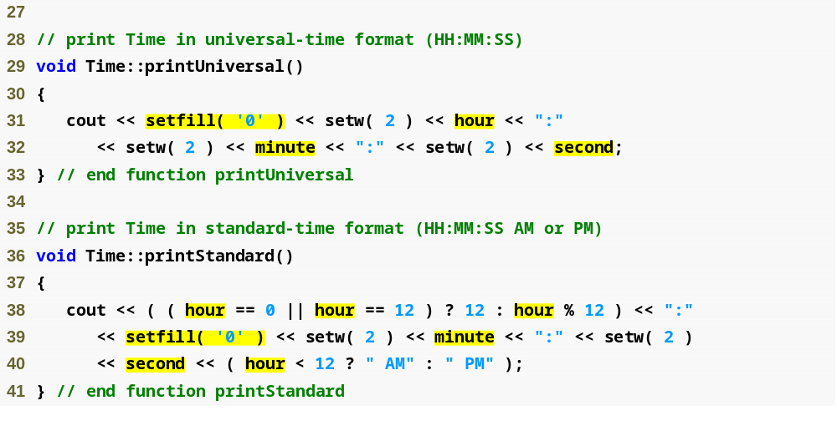
Using setfill stream manipulator to specify a fill character
Time.cpp
(2 of 2)
Example 1 - Time (Fig 09_03)
Military Time Chart: http://www.spacearchive.info/military.htm

Slide 23
9.2 Time Class Case Study (Cont.)
You'll notice the use of a stream manipulator we didn't use in CSIS 135, setfill
Parameterized stream manipulator setfill
  Specifies the fill character
    Which is displayed when the output field is wider than the number of digits in the output value
    By default, fill characters appear to the left of the digits in the number
  setfill is a “sticky” setting
    Applies for all subsequent values that are displayed in fields wider than the value being displayed
    So setfill is like setprecision or fixed but NOT like setw

Slide 24
Error-Prevention Tip 9.2
Each sticky setting (such as a fill character or floating-point precision) should be restored to its previous setting when it is no longer needed.
  Failure to do so may result in incorrectly formatted output later in a program. Chapter 15, Stream Input/Output, discusses how to reset the fill character and precision.
  If someone wants to look up how to reset the setting please do it and we can share it with the whole class after break
    I didn't have time to look it up this weekend

Slide 25
UML
What is the UML diagram for our Time class?
  Let's draw it on the board

Slide 26
Time Class Case Study (Cont.)
So in the example we are doing all of our member functions are implemented inside our class definition as a whole (inside the implementation section – Time.cpp) but declared outside our class declaration/specification (Time.h)
  So we're just saying the declaration/specification (the what of the class definition) is separate from the implementation (the how)
  If you design your class well you should be able to change the implementation without needing to change the declaration/specification (soda machine example)
The functions in the implementation section (Time.cpp) are:
    Still within the class’s scope (which class they belong with is indicated by the scope resolution operator ::)
    Known only to other members of the class (what are the other members of the class?) unless referred to via
      Object of the class
      Reference to an object of the class
      Pointer to an object of the class
Member functions CAN be defined and declared in the specification/declaration (.h) file
  This means the member functions are inline functions
  Defining a member function inside the class definition inlines the member function (if the compiler chooses to do so). This can improve performance – this would be the pro of using inlines
  The downfall is it violates the concept of abstraction and if the function is too long does not improve performance (compiler will ignore it if it's too long)
  You as the programmer will need to decide which functions should be inline and which should be regular functions

Slide 27
Defining Member Functions – Inline Functions
When designing a class you will need to decide which member functions to write as inline functions (entire function is in the declaration/specification - .h file) and which ones to define outside of the class declaration/specification as regular functions in the implementation section
Inline functions are handled completely differently by the compiler than regular functions are
  Understanding this difference will help you decide when to use which type of function
I have an example of an inline function commented out in Example #1

Slide 28
Defining Member Functions – Inline Functions
Regular Functions: how they are handled by the compiler
  When a regular function is called a number of special items including but not limited to the address to return to when the function is finished executing and the values of the function arguments (local parameter variables like we talked about in the first lecture) must be stored in a special section of memory called the stack.
    In addition, any local variables created in the function need to be stored on the stack as well as a location for the function’s return value
    All of this overhead that sets the stage for a regular function call takes CPU time
      Although this CPU time is miniscule, it can add up if the function is called many times such as in a loop
    We talked in detail about the function call stack and activation records in our introductory lecture, you should go back and review if you forgot this
Inline functions: how they are called by the compiler
  An inline function is not called in the same way as a regular function
  Instead a process called inline expansion is used where the compiler replaces every call to the function with the actual code of the function itself
    This means that if the function is called from multiple places in the program the entire body of functions code will be inserted into the program in place of every function call increasing the size of the program itself
    This is why only a function with very few lines of code should be written as an inline function
      In fact, if the inline function is too large to make the inline expansion practical, the compiler will ignore the request to handle the function this way and just handle it like a regular function anyway
      However when a member function is small it can improve performance to write it as an inline function because of the reduced overhead of not having to make actual function calls

Slide 29
Inline or Not?
Point: An inline function can improve performance if it's small
Point: Defining a small member function inside the class declaration (.h) does NOT promote the best software engineering, because clients of the class will be able to see the implementation of the function, and the client code must be recompiled if the function definition changes.
  If you have your implementation separate from your declaration and have designed it well you should be able to change your implementation without changing the declaration
Conclusion: Only the simplest and most stable member functions (i.e., whose implementations are unlikely to change) should be defined in the class header.

Slide 30
Software Engineering Observation 9.4
Using an object-oriented programming approach can often simplify function calls by reducing the number of parameters to be passed.
  This benefit of object-oriented programming derives from the fact that encapsulating data members and member functions within an object gives the member functions the right to access the data members of the class.
The fact that member function calls generally take either no arguments or substantially fewer arguments than conventional function calls in non-object-oriented languages reduces the likelihood of
  passing the wrong arguments, the wrong types of arguments or the wrong number of arguments.
Note that the printUniversal and printStandard functions take no arguments
    This is because the functions have direct access to the data members they operate on

Slide 31
Software Engineering Observation 9.5
Member functions of ADT definitions are usually shorter than functions in non-object-oriented programs, because the data stored in data members have ideally been validated by a constructor or by member functions that store new data (so you don't have to re-validate data as you would in procedural programming).
  Because the data is already in the object, the member-function calls often have no arguments or at least have fewer arguments than typical function calls in non-object-oriented languages.
  Thus, the calls are shorter, the function definitions are shorter and the function prototypes are shorter.
  This facilitates many aspects of program development.

Slide 32
9.2 Time Class Case Study (Cont.)
Using class Time
  Once class Time has been defined, it can be used in declarations of instances of Time data types in client programs
    (client programs create instances of the Time class definition which is really just a definition of an abstract data type)
    This is no different than how x is an instance of an int in the following declaration
      int x;
Examples of instances of the Time Class
    Time sunset;
    Time arrayOfTimes[ 5 ];
    Time &dinnerTime = sunset; //reference to a time object
    Time *timePtr = &dinnerTime;
Let's look at client program in Example 1 that tests the Time class

Slide 33
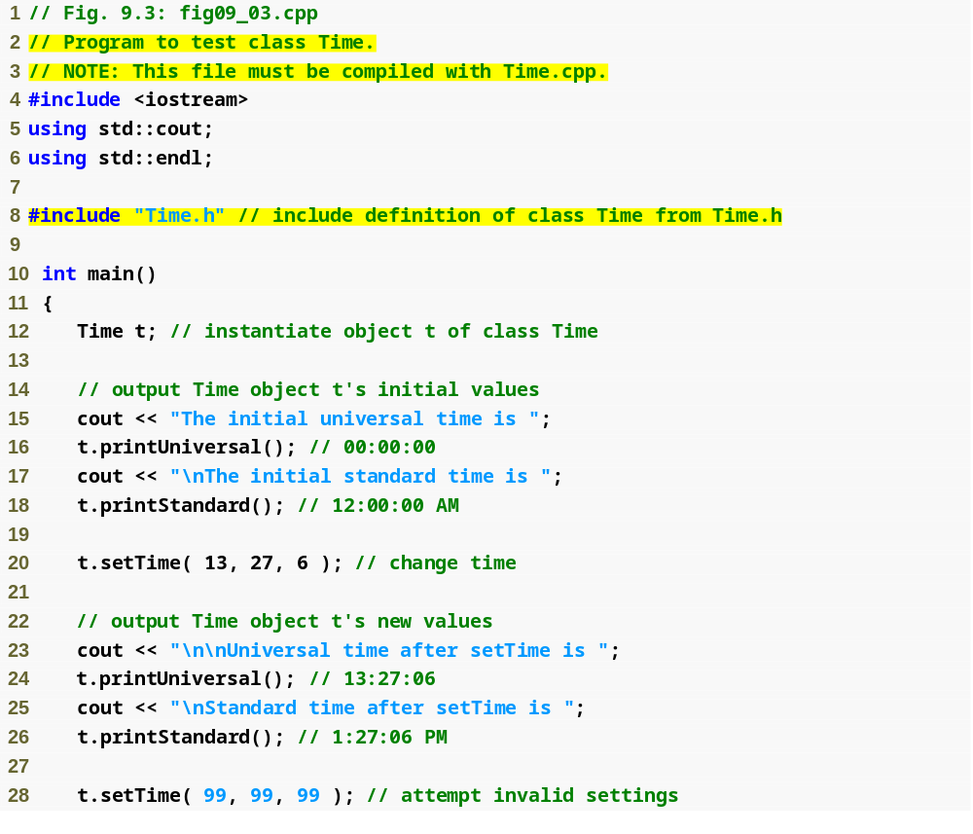
Example 1 - Time (Fig 09_03)
fig09_03.cpp
(1 of 2)

Slide 34
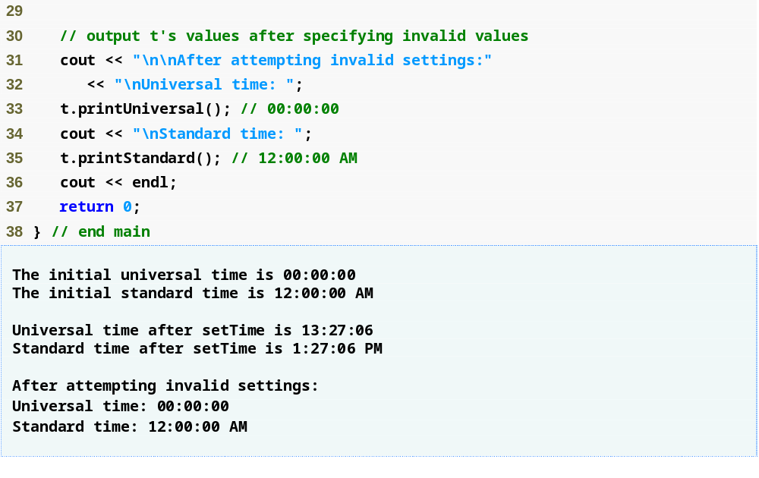
Example 1 - Time (Fig 09_03)
fig09_03.cpp
(2 of 2)

Slide 35
Setting Up Projects
Using Visual C++ to set up projects
  Step 1:
    Create a new project like usual
  Step 2:
    To the "Header Files" folder add a .h type file Time.h
  Step 3:
    To the "Source Files" folder add a .cpp type file Time.cpp and another .cpp type file fig09_03.cpp
  Then run the program as usual
IMPORTANT: The only way to get Homework #1 wrong is to send a procedural program it MUST BE OBJECT ORIENTED TO GET CREDIT

Slide 36
Performance Tip 9.2
Objects (instances of classes) contain only data (they only get copies of member variables not of member functions), so objects are much smaller than if they also contained member functions.
  Applying operator sizeof to a class name or to an object of that class will report only the size of the class’s data members.
    So each instance of a class (object) has its own copy of the class's data members
    Let's add some code to Example 1 to look at the size of our Time instance, t
  The compiler creates one copy (only) of the member functions separate from all objects of the class.
    All objects of the class share this one copy of the member functions.
    Each object, of course, needs its own copy of the class’s data, because the data can vary among the objects.
    The member function code is non-modifiable (also called reentrant code or pure procedure) and, hence, can be shared among all objects of one class.

Slide 37
9.3 Class Scope and Accessing Class Members
Dot member selection operator (.)
  Accesses the object’s members
  Used with an object’s name or with a reference to an object
Arrow member selection operator (->)
  Accesses the object’s members
  Used with a pointer to an object
Let's look at another example:
  Example 2 (fig09_04)

Slide 38
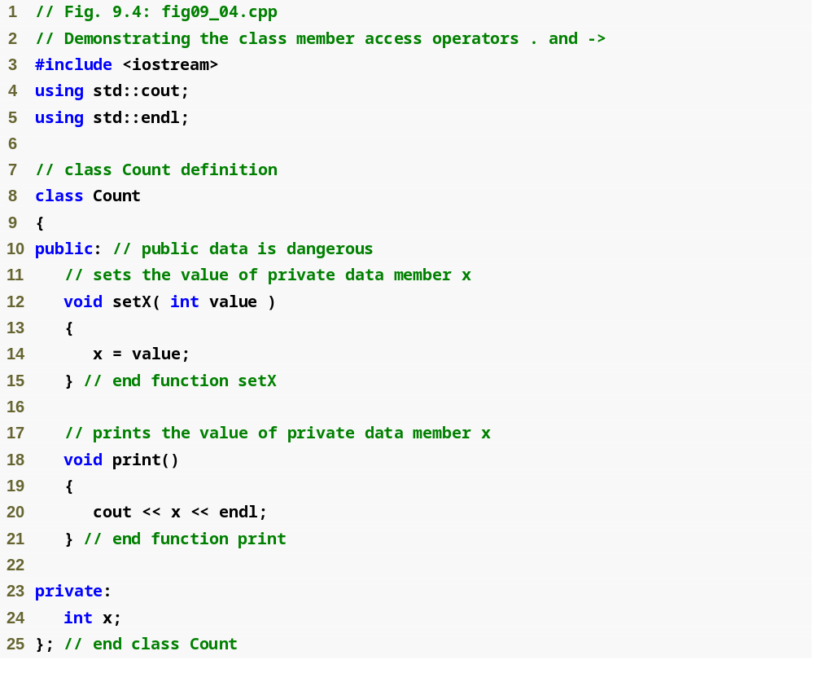
Example 2 - fig09_04.cpp
(1 of 2)
Your book put this entire example in one file since it's just an example, I have mine in three files just to make sure people don't forget to do that

Slide 39
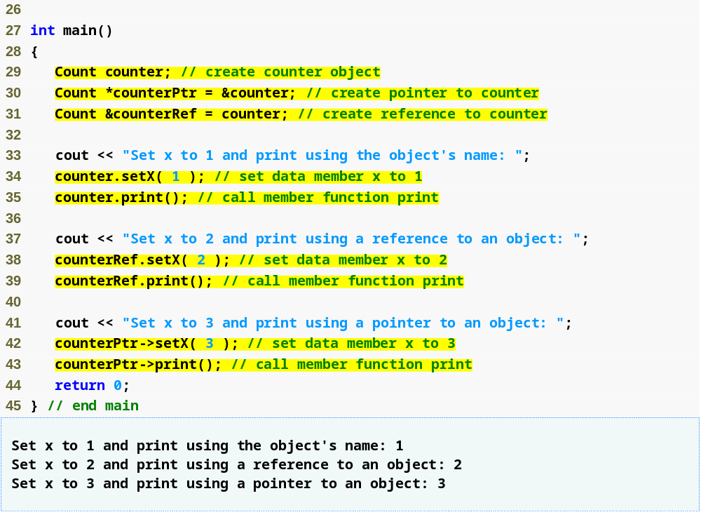
Example 2 - fig09_04.cpp
(2 of 2)
Using the dot member selection operator with an object
Using the dot member selection operator with a reference
Using the arrow member selection operator with a pointer

Slide 40
9.4 Separating Interface from Implementation
Separating a class definition (specification/declaration) and the class’s member-function definitions (implementation)
  The client doesn't need to the implementation to use the class only the specification
    Abstraction, keep the implementation details separate from how to use them to make using the class easier
  Makes it easier to modify programs
    Changes in the class’s implementation do not affect the client as long as the class’s interface remains unchanged
  Things are not quite this rosy
    Header files do contain some portions of the implementation and hint about others
      Inline functions need to be defined in header file
      private members are listed in the class definition in the header file
        these members are visible to clients even though the clients may not access the private members.
        Chapter 10 shows how to use a “proxy class” to hide even the private data of a class from clients of the class.

Slide 41
Software Engineering Observation 9.6
Clients of a class do not need access to the class’s source code in order to use the class.
  The clients do, however, need to be able to link to the class’s object code (i.e., the compiled version of the class).
  This encourages independent software vendors (ISVs) to provide class libraries for sale or license.
  The ISVs provide in their products only the header files and the object modules. No proprietary information is revealed—as would be the case if source code were provided.
  The C++ user community benefits by having more ISV-produced class libraries available.

Slide 42
Software Engineering Observation 9.7
Information important to the interface to a class should be included in the header file.
  So the header needs to give the client enough information to be able to easily use the class through the interface
Information that will be used only internally in the class and will not be needed by clients of the class should be included in the unpublished source file for the implementation.

Slide 43
9.5 Access Functions and Utility Functions
Access functions
  Can read or display data – do not modify data
    These should be const functions. Why do you think this is?
      Review, what is a const function?
  Can test the truth or falsity of conditions
    Such functions are often called predicate functions
    For example, isEmpty function for a class capable of holding many objects
Utility functions (also called helper functions)
  private member functions that support the operation of the class’s public member functions
  Not part of a class’s public interface
    Not intended to be used by clients of a class
Example 3 - (fig 09_07) – demonstrates a utility function
Take note of how member functions can call and use
other member functions
  You don't want to repeat the same task in several places
  in the class…why not?
In this class you really want to concentrate on DESIGN

Slide 44
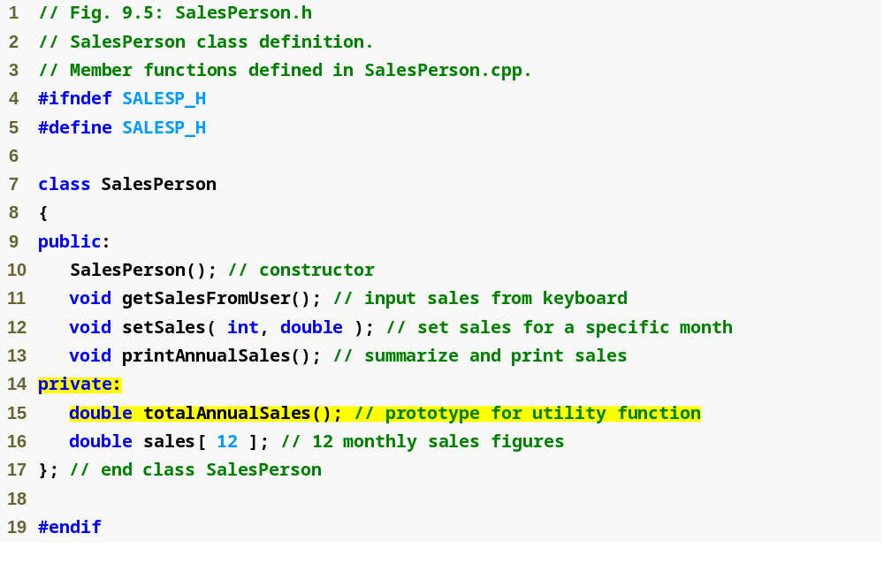
Example 3
SalesPerson.h
(1 of 1)
Prototype for a private utility function
Why is it good design to have a function that calculates
the total annual sales separate from a function that prints
the total annual sales?

Slide 45
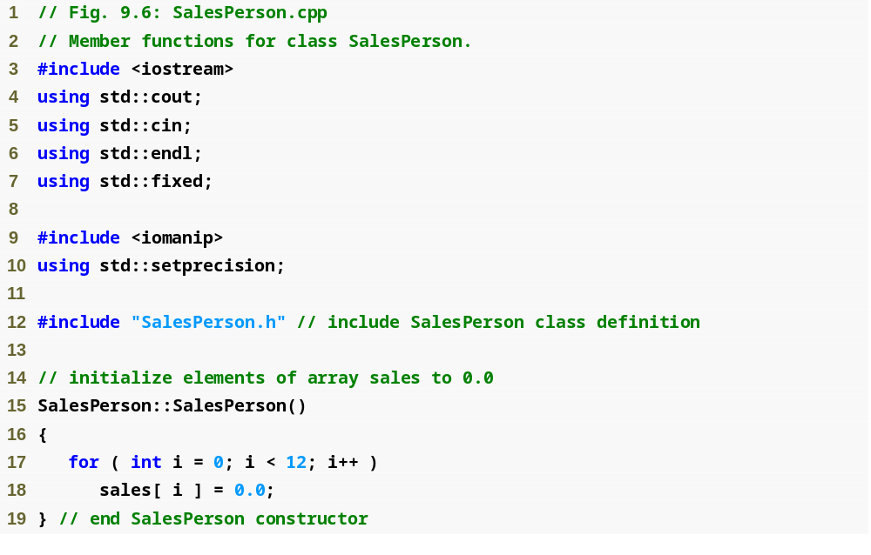
Example 3
SalesPerson.cpp
(1 of 3)

Slide 46
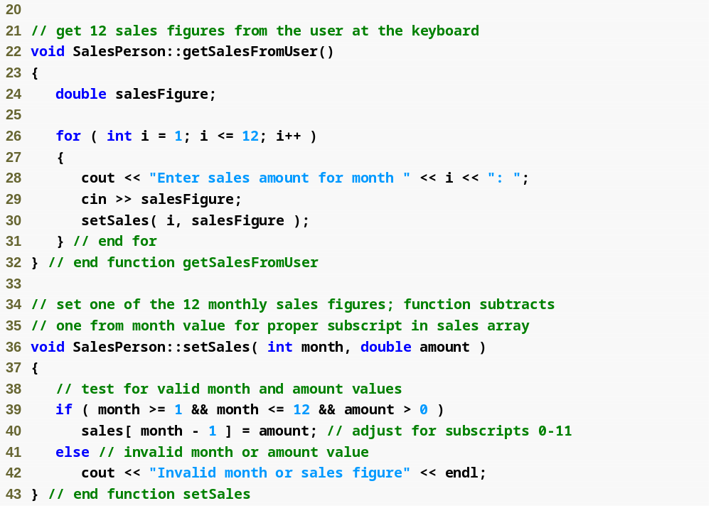
Example 3
SalesPerson.cpp
(2 of 3)
Is there something here
that could be designed
better? Why?

Slide 47
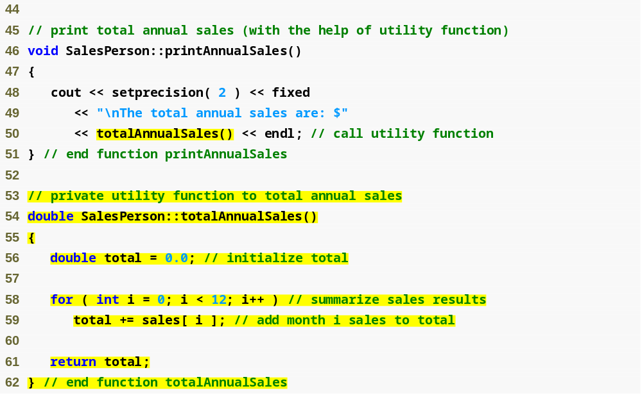
Calling a private utility function
Example 3
SalesPerson.cpp
(3 of 3)
Definition of a private utility function
Thinking about the Tic Tac Toe game for HW #1,
what member functions could be private utility functions?

Slide 48
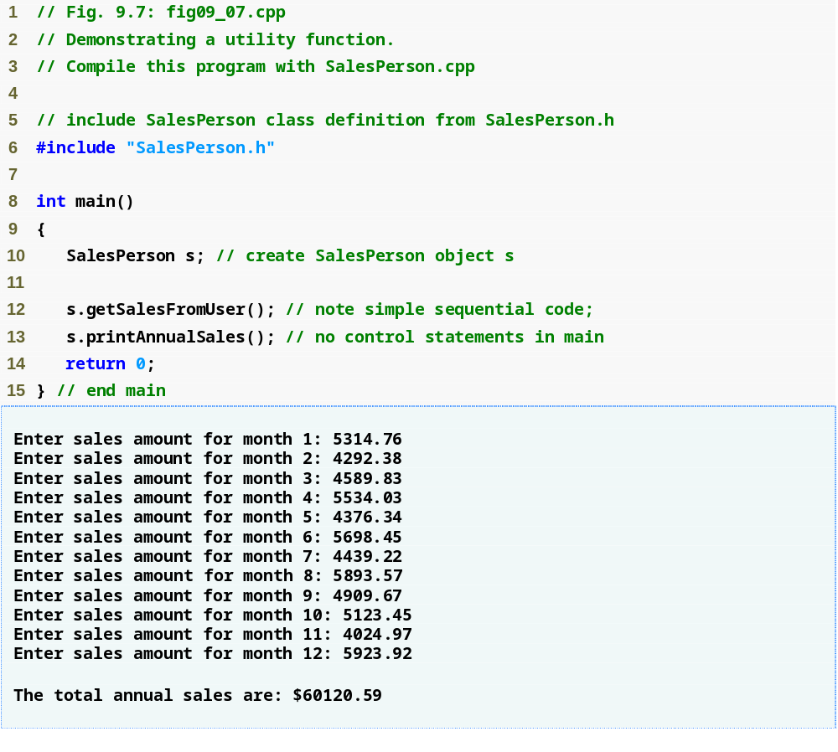
Example 3
fig09_07.cpp
(1 of 1)

Slide 49
Software Engineering Observation 9.8
A phenomenon of object-oriented programming is that once a class is defined, creating and manipulating objects of that class often involve issuing only a simple sequence of member-function calls
  few, if any, control statements are needed in the client program.
  By contrast, it is common to have control statements in the implementation of a class’s member functions.

Slide 50
9.6 Time Class: Constructors with Default Arguments
Constructors can specify default arguments
  Can initialize data members to a consistent state
    Even if no values are provided in a constructor call
  Constructor that defaults all its arguments is also a default constructor
    Can be invoked with no arguments
    Maximum of one default constructor per class
Basically what this is talking about is it's saying that a constructor that has all default arguments is really a default constructor
  It can be called by passing in no arguments
  It can be called by passing in some or all of the arguments as long as they are passed in order, no skipping
Example 4

Slide 51
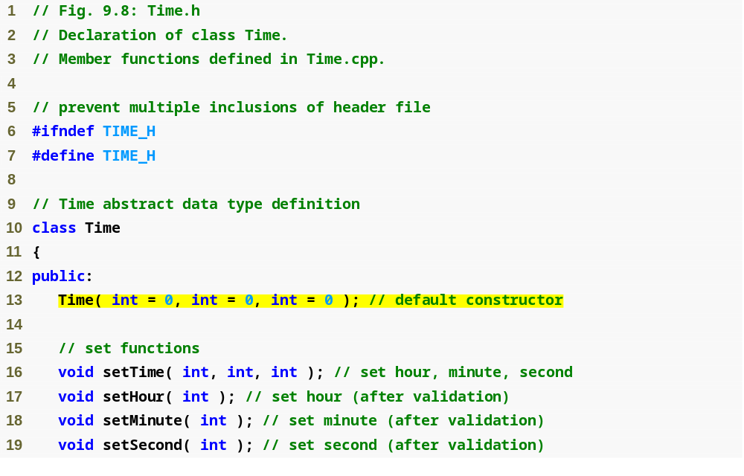
Example 4
Time.h
(1 of 2)
Prototype of a constructor with default arguments

Slide 52
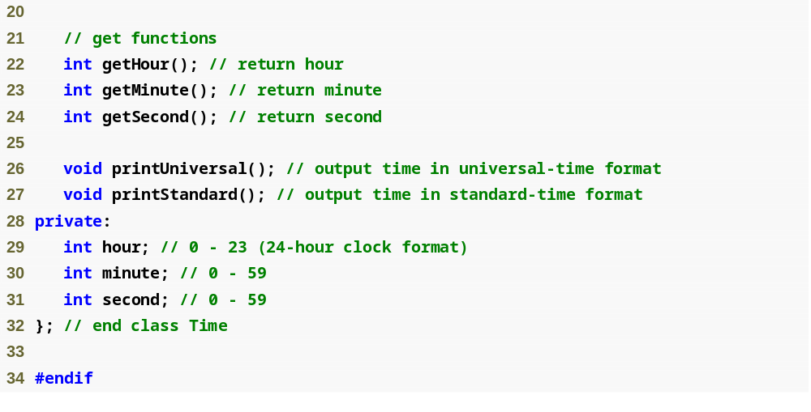
Example 4
Time.h
(2 of 2)

Slide 53
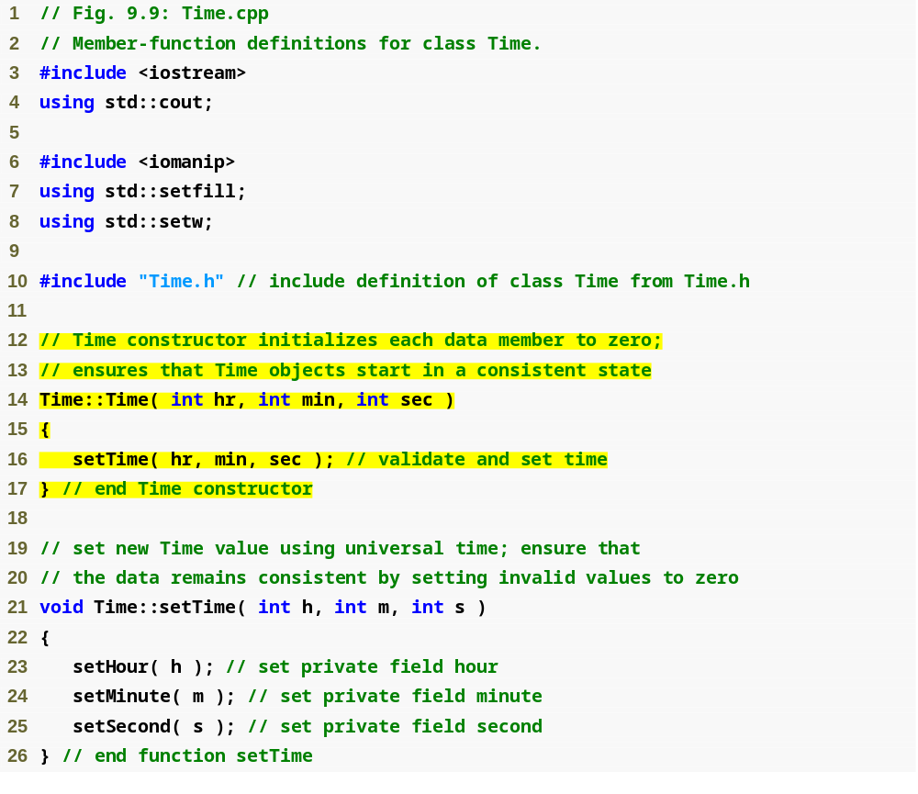
Example 4
Time.cpp
(1 of 3)
Parameters could receive the default values
Why do we call the
setTime function in the
constructor instead of just
repeating the same code
in the setTime member
function?

Slide 54
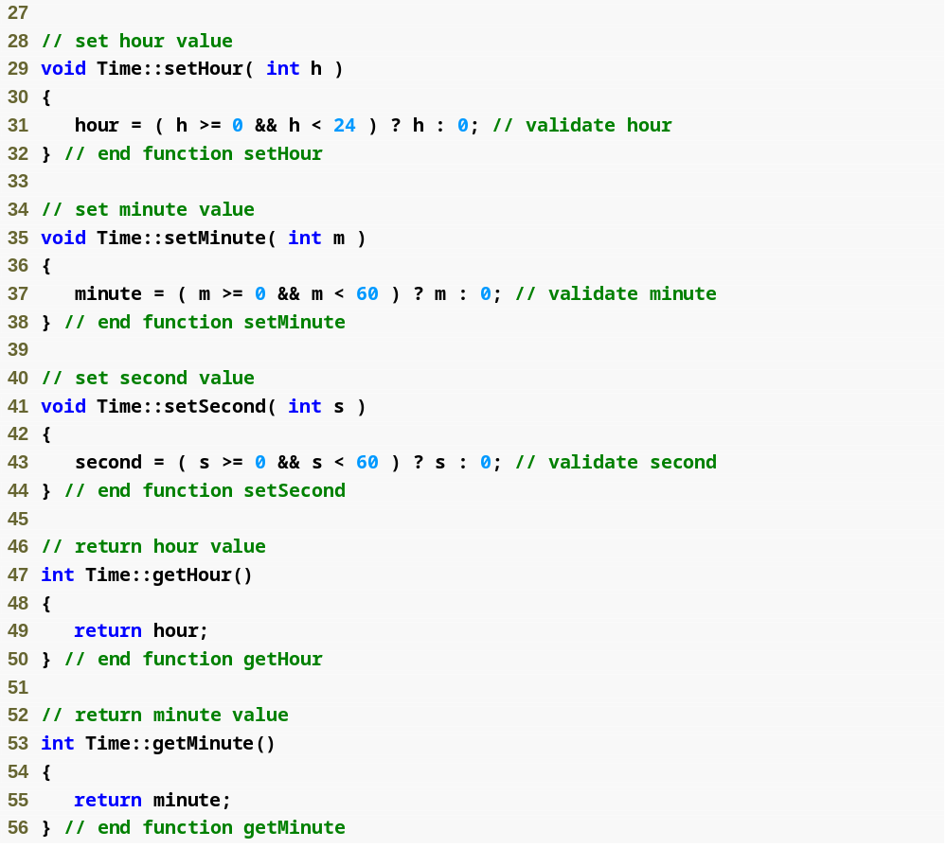
Example 4
Time.cpp
(2 of 3)

Slide 55
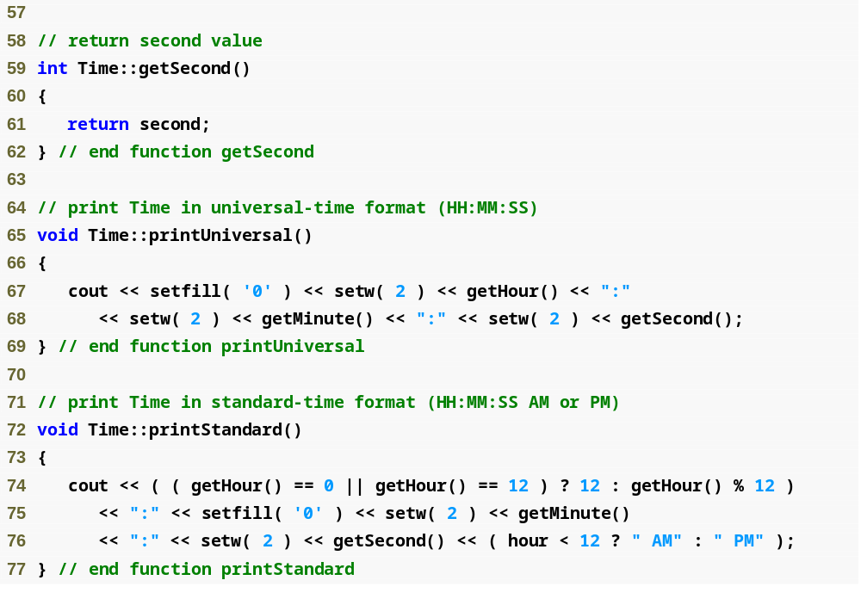
Example 4
Time.cpp
(3 of 3)
Question: Why do we call get methods in the print functions such as getMinute() instead of directly accessing the minute
member variable?

Slide 56
Software Engineering Observation 9.9
If a member function of a class already provides all or part of the functionality required by a constructor (or other member function) of the class, call that member function from the constructor (or other member function).
  This simplifies the maintenance of the code and reduces the likelihood of an error if the implementation of the code is modified.
  As a general rule: Avoid repeating code.
Let's look at the constructor again

Slide 57
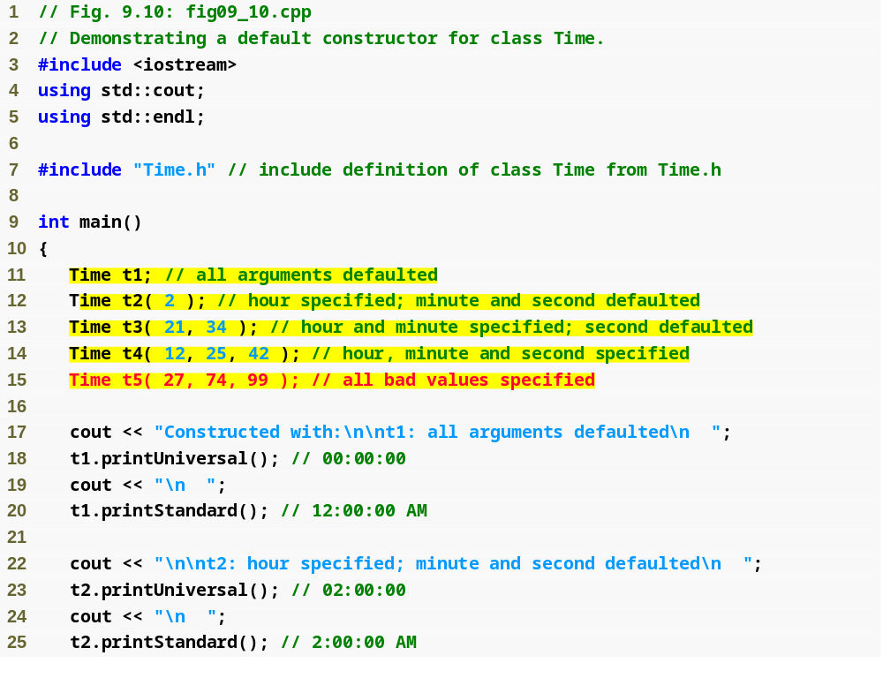
Initializing Time objects using 0, 1, 2 and 3 arguments
Example 4
fig09_10.cpp
(1 of 3)

Slide 58
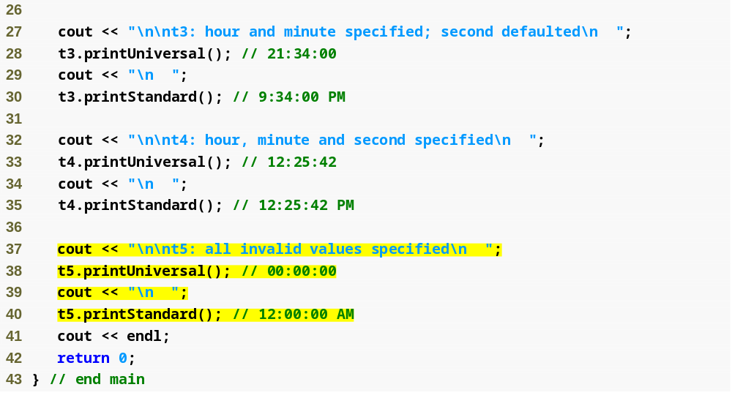
Example 4
fig09_10.cpp
(2 of 3)

Slide 59
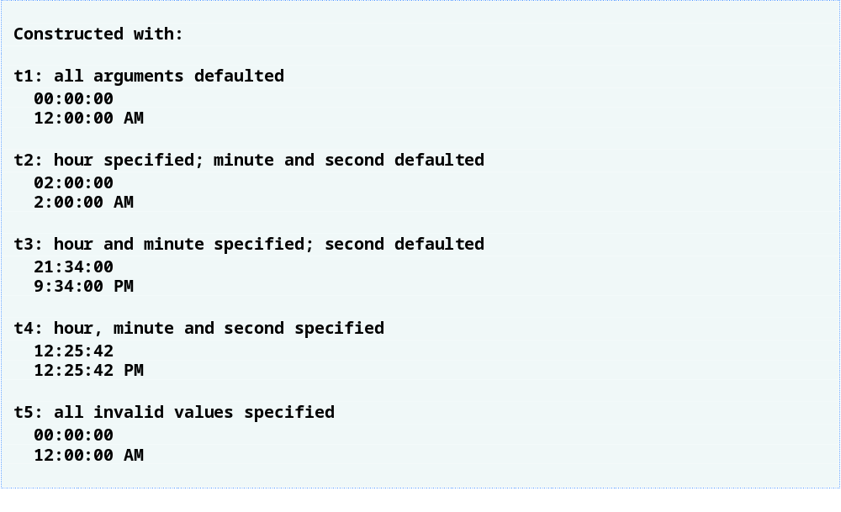
Example 4
fig09_10.cpp
(3 of 3)
Invalid values passed to constructor, so object t5 contains all default data

Slide 60
Destructors
Concept: A destructor is a member function that is automatically called when an object is destroyed
A destructor is a counterpart of the constructor function
  Has same name as the class
    Preceded with a tilde character (~)
  Time class destructor: ~Time()
Destructors are automatically called when an object is destroyed.
  In the same way that constructors can be used to set things up when an object is created destructors are used to perform shutdown type procedures when an object goes out of existence
  The destructor doesn't actually release the object's memory, it instead performs termination housekeeping before the object's memory is reclaimed so the memory may be reused to hold new objects
More points on Destructors:
  Destructors have no return type
  Destructors cannot accept arguments so they never have a parameter list (the list is always empty ~Time();
  Because Destructors can accept no arguments there can only be one Destructor
  The destructor must be public
Destructors are most useful when working with objects that have dynamically allocated members
  We'll see/review this in the next lecture – if you took CSIS 135 with me (depending on which semester) you may know dynamically allocated members are members whose memory is allocated at run time from the heap rather than at compile time, that memory needs to be released after it is used

Slide 61
Calling Constructors & Destructors
Both Constructors and Destructors are implicitly called by the compiler
  The order of calls depends on the order in which execution enters and leaves the scopes where the objects are instantiated
  Generally destructors are called in the reverse order of their corresponding constructor calls (so think of it as objects of the same "level" are destroyed in reverse order of their corresponding constructor calls)
If objects are defined in global scope (global objects) (outside of all functions)
  Their constructors are called before any other function in the file (including main) begins to execute
  The corresponding destructors are called when main ends
Notes:
  The exit function terminates a program immediately but does NOT execute the destructors of automatic objects (by automatic they mean not static or global – so local objects declared inside functions)
  The abort function is similar to the exit function but does not allow the destructors of ANY objects to be called
  These are therefore NOT good functions to use in your programs, these are procedural programming tricks that are in general not good software engineering

Slide 62
Calling Constructors & Destructors
The constructor for an automatic local object is called when execution reaches the point where that object is defined
  The corresponding destructor is called when the program execution leaves the object's scope (the block in which the object is defined has finished executing)
  Constructors and destructors for automatic local objects
Static local objects (remember a static variable or object in a function is not destroyed when the function ends like normal local variables)
  The constructor for static local objects is called only once, when execution reaches the point where the static object is defined
  The destructor for a static object is called when main ends or when the function exit is called, the destructor for a static object is not called if the function abort is called
Let's look at Example 5
  This is set up just to illustrate the points on when objects constructors and destructors are called
  Note the destructors are called in reverse order of the constructors with this priority
    automatics, statics/globals

Slide 63
Memberwise Assignment
Concept: The = operator may be used to assign one object to another or to initialize one object with another object’s data.
  By default, each data member (member variable) of one object is copied to its counterpart in the other object
Best seen with an example
  Let’s use a revised Circle Class Example

Slide 64
Memberwise Assignment
Example 6:
class Circle //class declaration
{
private:
double radius;
string color;
public: //function prototypes
Circle(double, string);
void setRadius(double);
void setColor(string);
double getRadius();
string getColor();
};

Slide 65
Memberwise Assignment
Example 6:
//IMPLEMENTATION SECTION
Circle::Circle(double r, string color){
setRadius(r);
setColor(color);
}
void Circle::setRadius(double r) {
if(r > 0)
radius = r;
else
radius = 0;
}
void Circle::setColor(string color) {
this->color = color;
}
double Circle::getRadius(){
return radius;
}
string Circle::getColor(){
return color;
}

Slide 66
Memberwise Assignment
Example 6:
int main()
{
Circle circ1(50.25, "Red");
Circle circ2(10.25, "Blue");
cout << "\nBEFORE memberwise assignment circ1 is " << circ1.getColor()
<< " and circ1's radius is " << circ1.getRadius() << endl;
cout << "BEFORE memberwise assignment circ2 is " << circ2.getColor()
<< " and circ2's radius is " << circ2.getRadius() << endl;
circ2 = circ1;
cout << "\nAFTER memberwise assignment circ1 is " << circ1.getColor()
<< " and circ1's radius is " << circ1.getRadius() << endl;
cout << "AFTER memberwise assignment circ2 is " << circ2.getColor()
<< " and circ2's radius is " << circ2.getRadius() << endl;
return 0;
}

Slide 67
Memberwise Assignment
Memberwise assignment also occurs when one object is initialized with another object’s values.
Example:
    Circle circ1;
    circ1.setRadius(1.0);
    circ1.setColor(“Purple”);
    Circle circ2 = circ1;
  The fourth statement defines a Circle object circ2, and initializes it to the values stored in circ1.
    Because memberwise assignment takes place, the circ2 object will contain the exact same values as the circ1 object

Slide 68
Copy Constructors
Copy constructor: A copy constructor is a special constructor that is called whenever a new object is created and initialized with the data of another object of the same class or when an assignment operator is used with two objects
Initializes an object using another object of same class
  Example: Two equivalent formats
      Circle circ2 = circ1;
      Circle circ2(circ1);
Remember that a constructor is executed whenever an object is created (initialized)
  Similarly, the compiler automatically calls a special constructor called the copy constructor to perform the initialization using the existing object’s data
Default copy constructor: Constructed by compiler if none declared by programmer
  Similar to default assignment constructor
  Performs memberwise copy between objects
  Does not work well with pointer data members
Programmer defined copy constructors: The programmer can also define their own copy constructor
  The default constructor works pretty well unless pointers are involved
  One way to have variable sized arrays in a class is to use pointers to arrays instead of array declarations themselves, this is a time when a programmer defined copy constructor might also be used
A programmer defined copy constructor has the same name of the class and a single parameter that is a reference to the SAME class
  Circle::Circle(Circle &obj)
If your class has pointers you MUST define your own copy constructor and not use the default constructor, a common mistake is forgetting to define a copy constructor and/or forgetting when the copy constructor gets called

